Slide 1
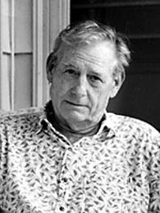
Wayne Theibaud
Wayne Thiebaud (born November 15, 1920) is an American painter whose most famous works are of cakes, pastries, and other production line objects. He is associated with the Pop art movement because of his interest in objects of mass culture. Thiebaud uses heavy pigment and exaggerated colors to depict his subjects, and the well-defined shadows characteristic of advertisements are almost always included in his work.

Slide 2
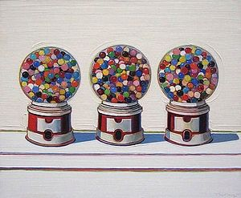
300 × 247 - en.wikipedia.org

Slide 3
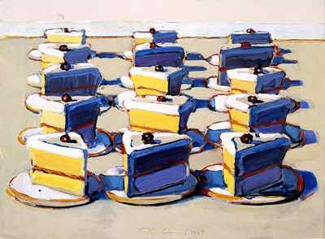

Slide 4
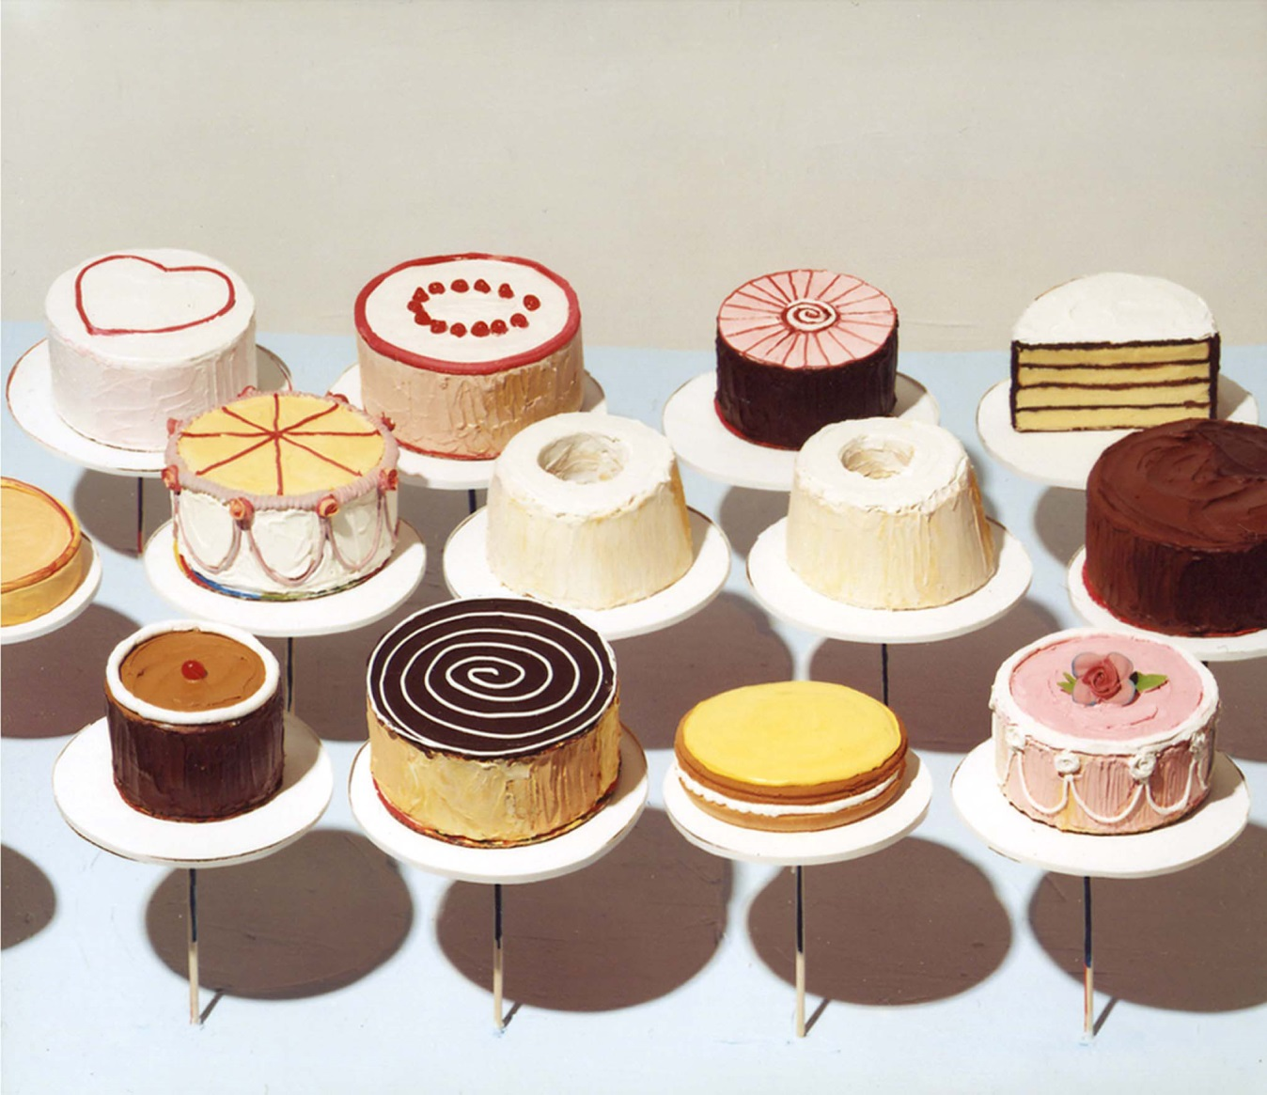

Slide 5
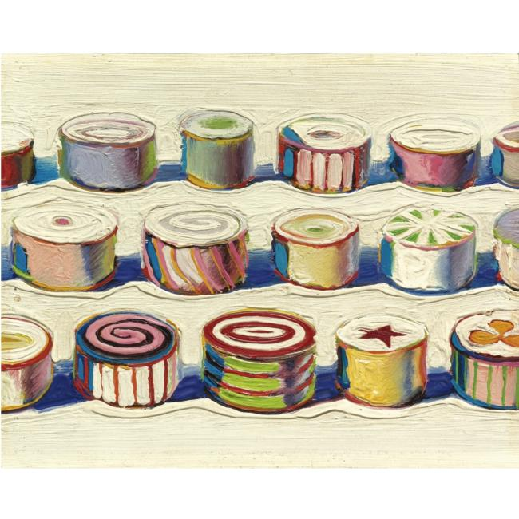

Slide 6
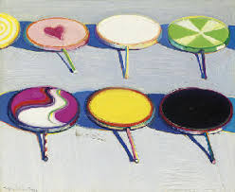
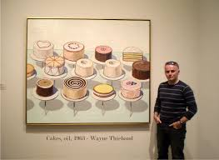
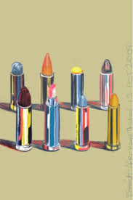
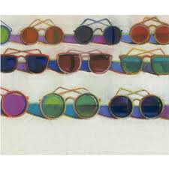
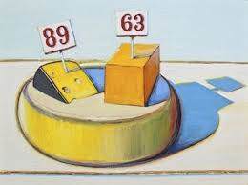
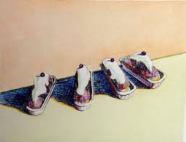

Slide 7
